Slide 1



Cyber Security Analysis
Hrishikesh Yadav

Slide 2


01
How does Albania's cybersecurity metrics (CEI, GCI, NCSI) compare to other European countries?

Slide 3
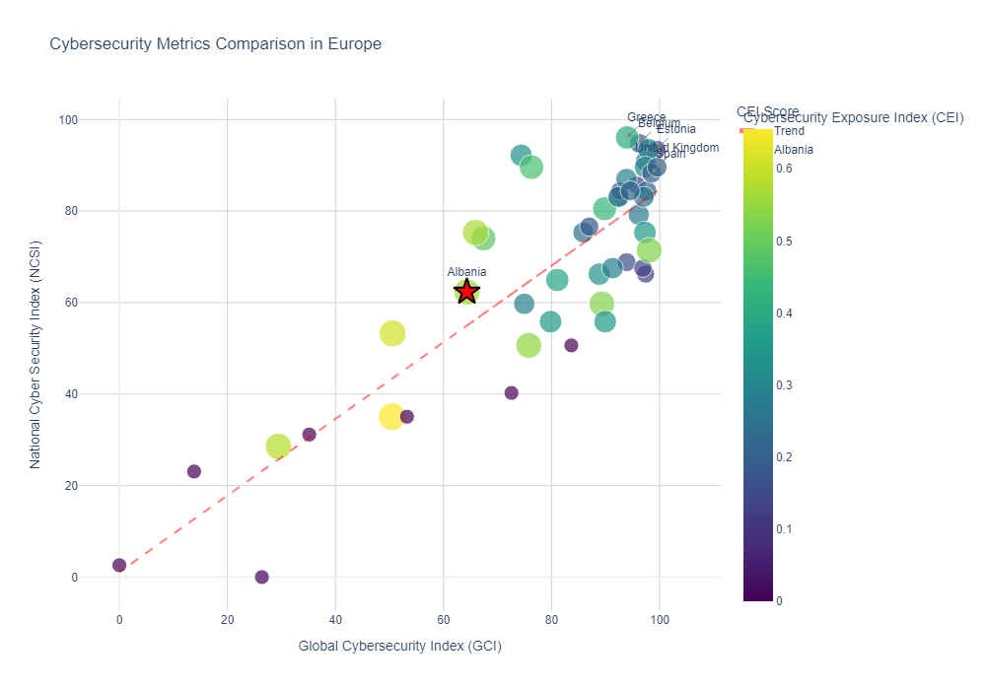


Albania's cybersecurity metrics (CEI, GCI, NCSI) compare to other European countries
Albania's ranking in Europe for CEI - 5.0/48
Albania's ranking in Europe for GCI - 40.0/48
Albania's ranking in Europe for NCSI - 33.0/48
Albania's ranking in Europe for DDL: 43.0/48
Albania has opportunities for improvement in both GCI and NCSI compared to other European countries.

Slide 4
02
Which country in Africa has the highest NCSI and how does its DDL relate to its other cybersecurity indicators?

Slide 5
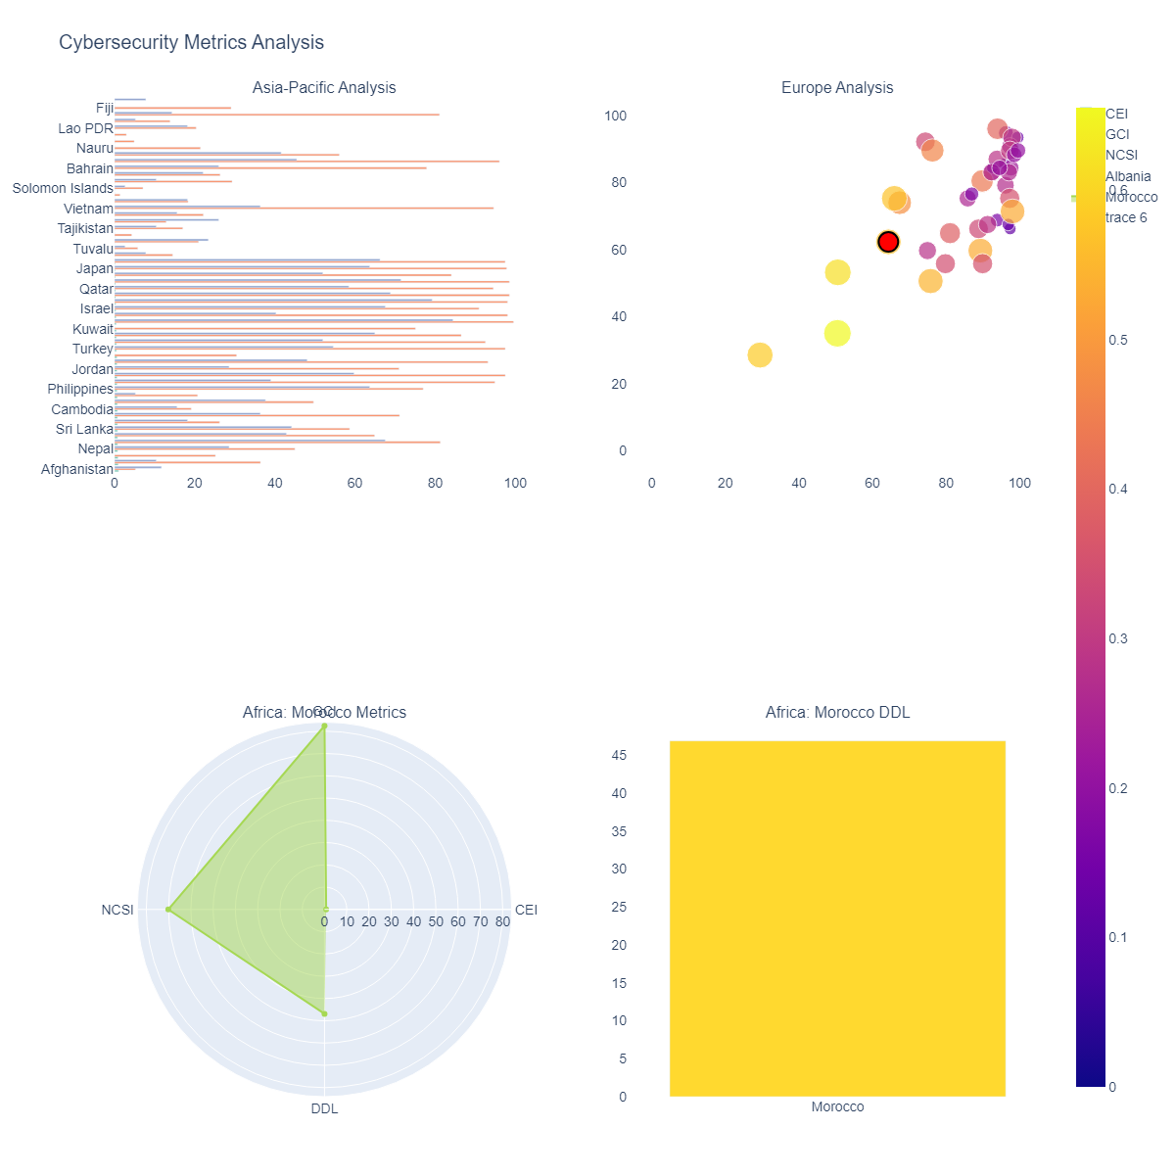
Country in Africa has the highest NCSI and how does its DDL relate to its other cybersecurity indicators
Highest CEI in Asia-Pacific: Afghanistan (CEI: 1.000)
Albania's metrics -
CEI: 0.566
GCI: 64.320
NCSI: 62.340
Highest NCSI in Africa: Morocco (NCSI: 70.130)

Slide 6
04
What is the relationship between CEI and GCI for countries in South America?

Slide 7
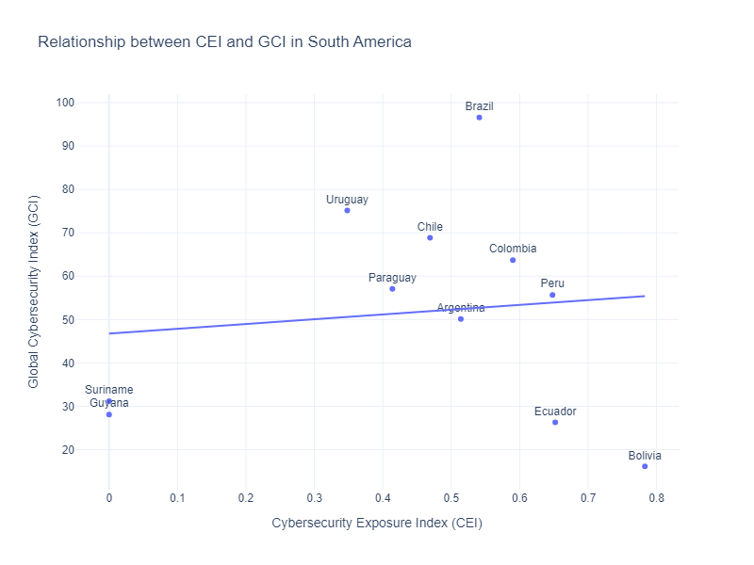
Relationship between CEI and GCI for countries in South America
Correlation between CEI and GCI in South America - 0.115
The correlation coefficient of 0.115 indicates a very weak positive relationship between CEI and GCI in South American countries. This suggests that as one metric increases, the other tends to increase only slightly.

Slide 8
05
Which countries in North America have the lowest Cybersecurity Exposure Index (CEI), and how does it relate to their GCI and NCSI?

Slide 9
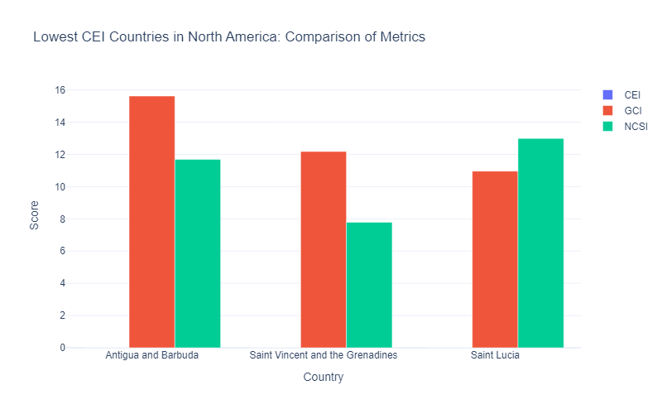
Which countries in North America have the lowest Cybersecurity Exposure Index (CEI), and how does it relate to their GCI and NCSI?
Island nations with limited online presence.
Limited funds for cybersecurity initiatives.
Other economic issues may take precedence.
Tourism focused economies of the country
Reduced need for extensive connectivity.

Slide 10
06
) How does Argentina's NCSI score compare with other South American countries, and what trends can be observed?

Slide 11
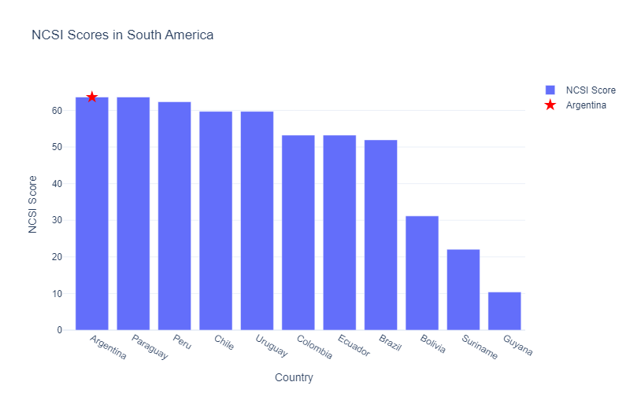
How does Argentina's NCSI score compare with other South American countries, and what trends can be observed?
Argentina ties for highest NCSI score in South America.
Significantly higher than regional average (63.64 vs 48.29).
Several countries close behind (Paraguay, Peru, Chile, Uruguay).
Colombia, Ecuador, Brazil form a middle cluster.
Wide range of scores (63.64 to 10.39) indicates varied cybersecurity capabilities.

Slide 12
07
What is the correlation between Digital Development Level (DDL) and Global Cybersecurity Index (GCI) across different regions?

Slide 13
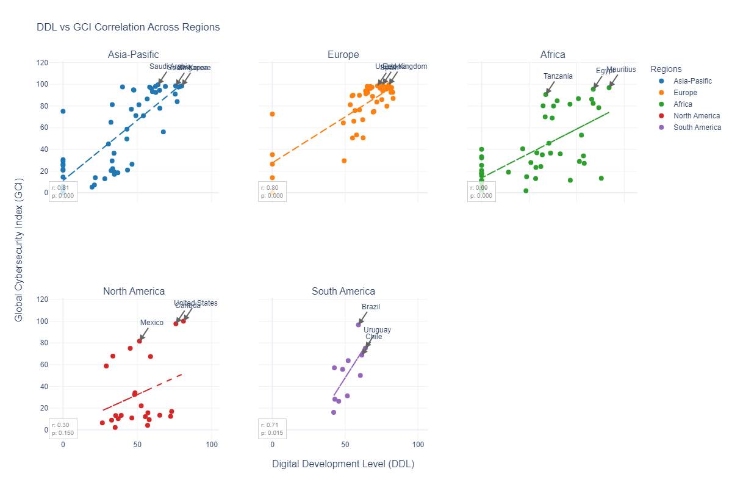
What is the correlation between Digital Development Level (DDL) and Global Cybersecurity Index (GCI) across different regions?

Slide 14
08
Which countries exhibit a high CEI but low NCSI, and what does that imply about their cybersecurity status?

Slide 15
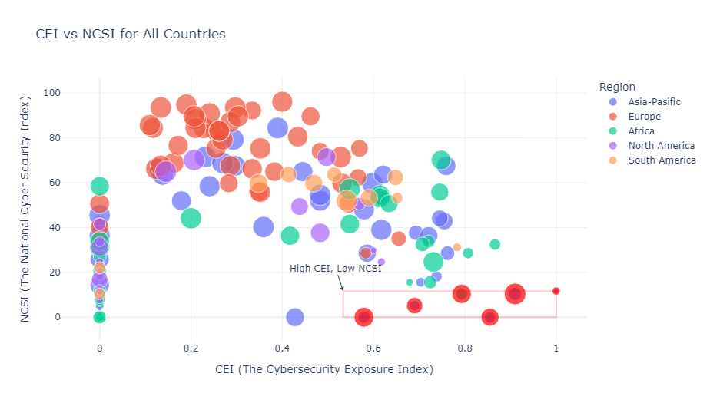
Which countries exhibit a high CEI but low NCSI, and what does that imply about their cybersecurity status?
Countries with high CEI but low NCSI may be more exposed to cyber threats while having less developed national cybersecurity capabilities. This suggests a need for these countries to strengthen their cybersecurity measures and policies to better protect against their high exposure.

Slide 16
09
How do countries in Europe compare in terms of CEI vs. DDL levels? Are there any clear patterns or anomalies?

Slide 17
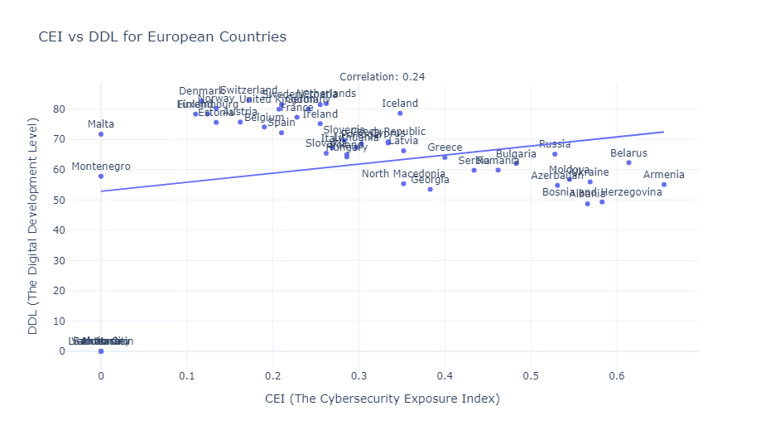
Which countries exhibit a high CEI but low NCSI, and what does that imply about their cybersecurity status?
1. There appears to be a negative correlation between CEI and DDL in European countries.
2. Countries with higher DDL tend to have lower CEI, suggesting better digital development might contribute to lower cybersecurity exposure.
3. Anomalies might represent countries that have unusually high or low DDL compared to their CEI, which could indicate unique cybersecurity situations or data anomalies.

Slide 18
10
What are the top 5 countries with the highest GCI scores globally, and what are their CEI and NCSI values?

Slide 19
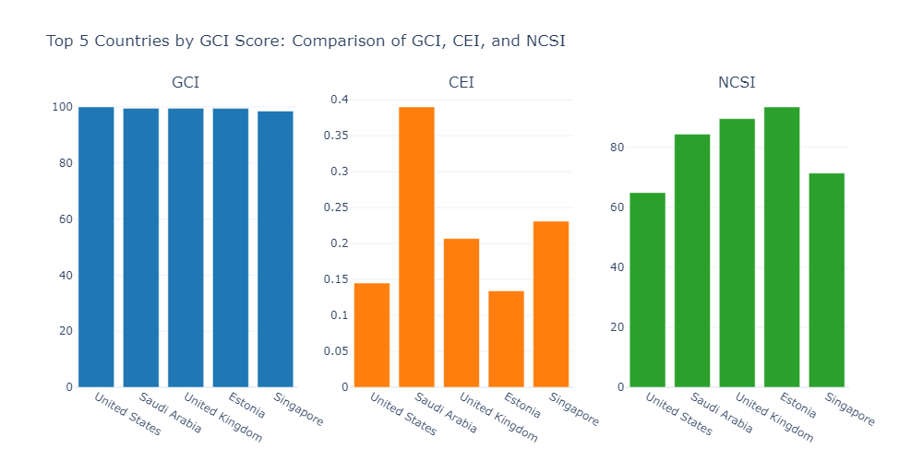
What are the top 5 countries with the highest GCI scores globally, and what are their CEI and NCSI values?

Slide 20
11
What is the regional distribution of countries with a CEI of 0, and what could explain the cybersecurity status in those regions?

Slide 21
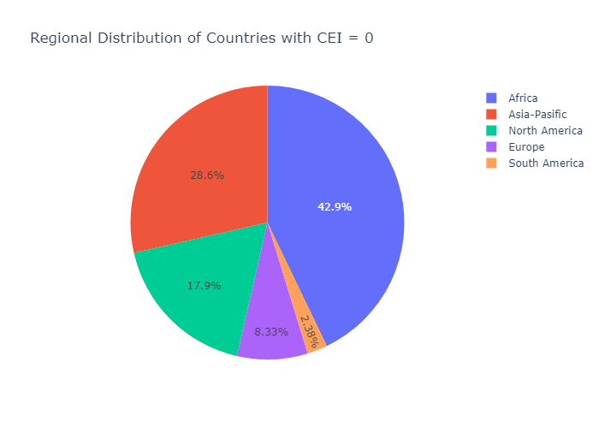
What is the regional distribution of countries with a CEI of 0, and what could explain the cybersecurity status in those regions?
Possible explanations for CEI = 0: 1
1. Limited digital infrastructure or internet penetration
2. Lack of data or reporting on cybersecurity incidents
3. Strong cybersecurity measures effectively minimizing exposure
4. Geopolitical factors influencing cybersecurity landscape
5. Potential data collection or measurement issues

Slide 22
12
How does Canada's GCI compare with other North American countries, and what factors contribute to its ranking?

Slide 23
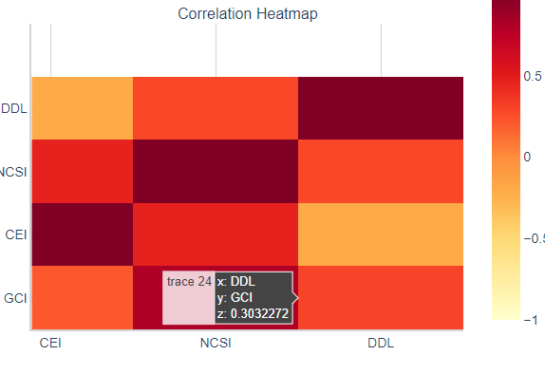
How does Canada's GCI compare with other North American countries, and what factors contribute to its ranking?
Canada demonstrates strong cybersecurity measures compared to its North American counterparts. Particularly strong in NCSI, Canada could focus on enhancing its CEI to further strengthen its cybersecurity posture.

Slide 24
14
What patterns emerge when comparing CEI scores across different regions (Africa, Europe, Asia-Pacific, etc.)?

Slide 25
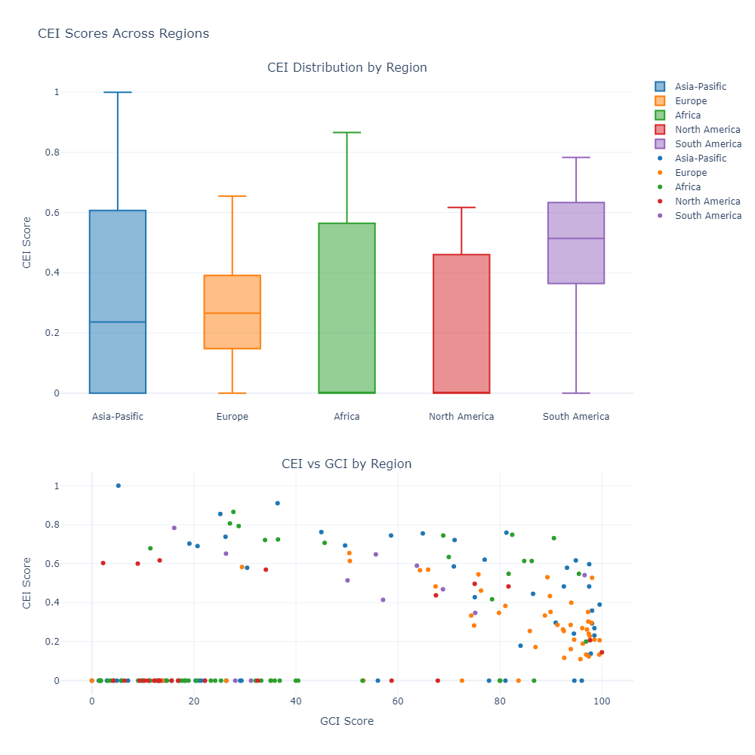
What patterns emerge when comparing CEI scores across different regions (Africa, Europe, Asia-Pacific, etc.)?
1. South America has the highest average CEI, suggesting potentially higher cybersecurity exposure.
2. North America has the lowest average CEI, indicating potentially better overall cybersecurity measures.
3. Asia Pacific shows the most variation in CEI scores, suggesting diverse cybersecurity landscapes within the region.
4. There appears to be a negative correlation between CEI and GCI scores across regions, indicating that countries with better cybersecurity measures (higher GCI) tend to have lower cybersecurity exposure (lower CEI).

Slide 26
15
How does the Digital Development Level (DDL) impact the GCI scores within the Asia-Pacific region?

Slide 27
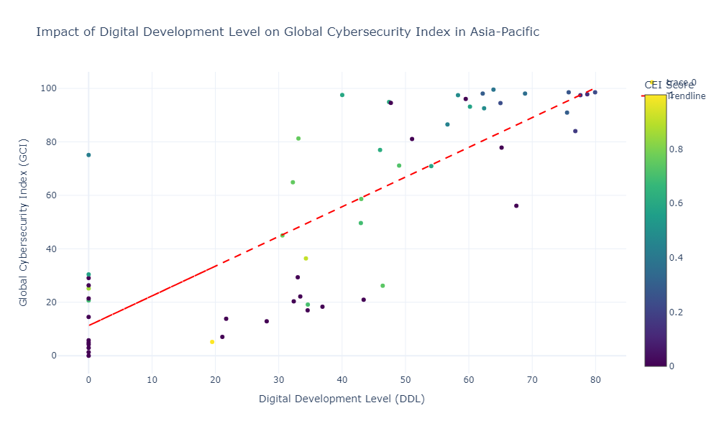
How does the Digital Development Level (DDL) impact the GCI scores within the Asia-Pacific region?
There is a positive correlation between DDL and GCI in the Asia-Pacific region.

Slide 28
Can countries be clustered into groups based on their CEI, NCSI, and GCI scores?
16
Is there a strong correlation between Digital Development Level (DDL) and Global Cybersecurity Index (GCI) across all countries?

Slide 29
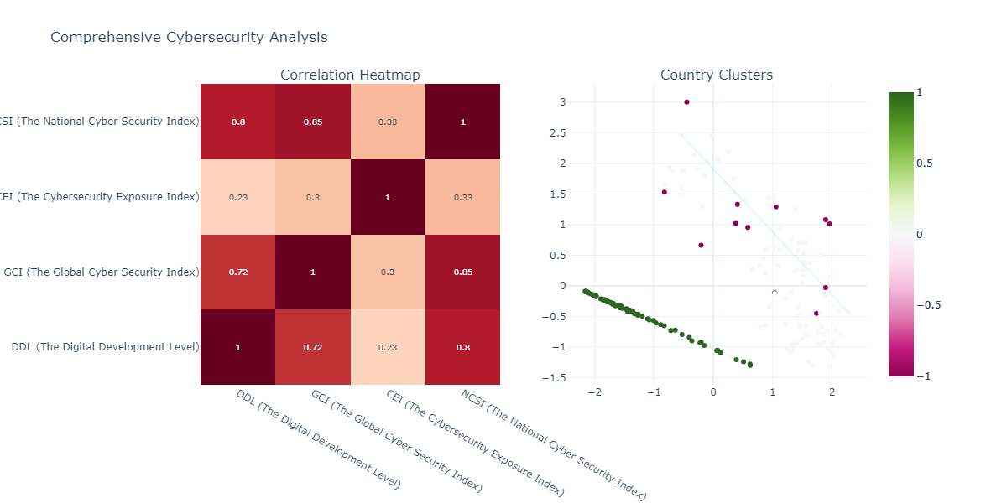
Is there a strong correlation between Digital Development Level (DDL) and Global Cybersecurity Index (GCI) across all countries?
Can countries be clustered into groups based on their CEI, NCSI, and GCI scores?

Slide 30
Cluster Analysis Insights
Number of clusters: 2
Number of noise points: 12
Cluster -1 (12 countries): Afghanistan, Bangladesh, Czech Republic, Ecuador, Jordan...
Cluster 0 (96 countries): Albania, Algeria, Argentina, Armenia, Australia...
Cluster 1 (84 countries): Andorra, Angola, Antigua and Barbuda, Bahamas, Bahrain...
Correlation between DDL and GCI: 0.722 (p-value: 0.000)

Slide 31
Which region performs best overall in terms of NCSI scores, and what regional trends can be observed?
18
Identify countries with extremely high CEI but low GCI or NCSI and investigate the reasons behind these outliers.

Slide 32
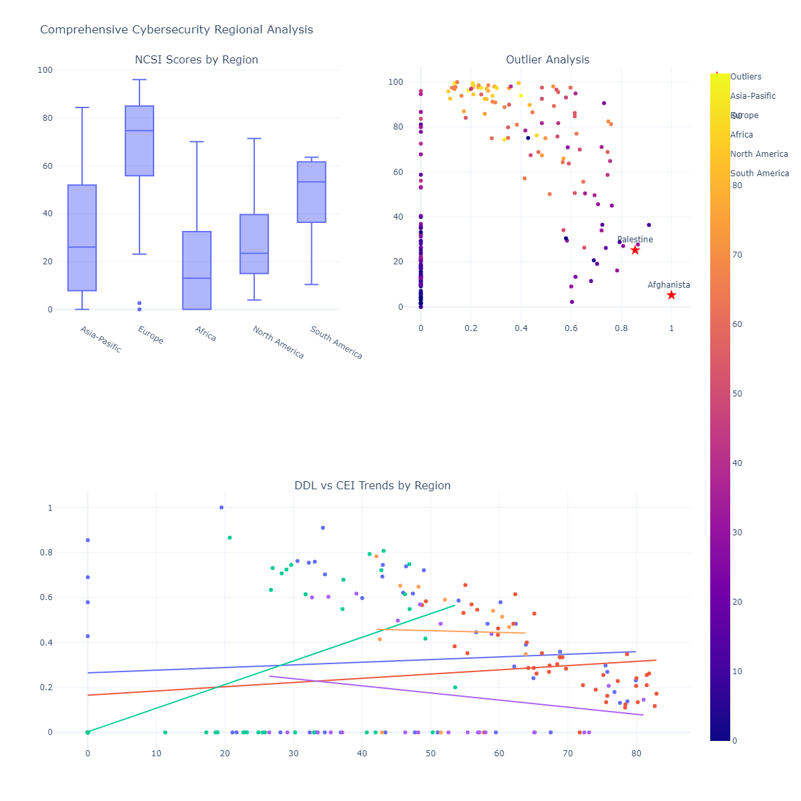

Slide 33
19
Explore how Digital Development Level (DDL) trends with Cybersecurity Exposure Index (CEI) across different regions.

Slide 34
Explore how Digital Development Level (DDL) trends with Cybersecurity Exposure Index (CEI) across different regions.

